Slide 1

Fundamental Of Structured Programming Lecture 10
Dr. Ahmed Yousry
Lecturer, Computer Science Department,
Faculty of computers and artificial intelligence, benha university

Slide 2


Slide 3
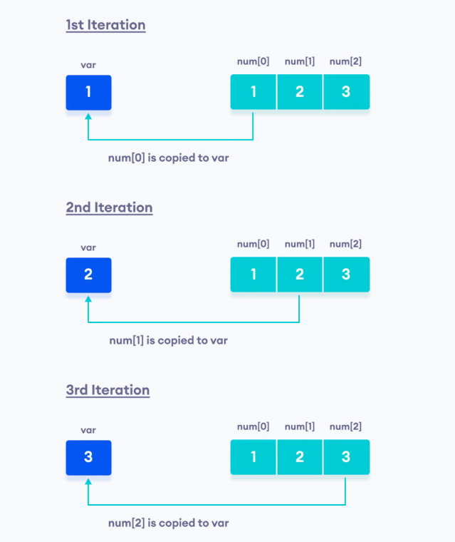

The Range-Based for Loop
The range-based for loop is designed to work with a built-in variable known as the range variable.
Each time the range-based for loop iterates, it copies an array element to the range variable.
Example, the first time the loop iterates, the range variable will contain the value of element 0,
The second time the loop iterates, the range variable will contain the value of element 1, and so forth.
The General Form:

Slide 4
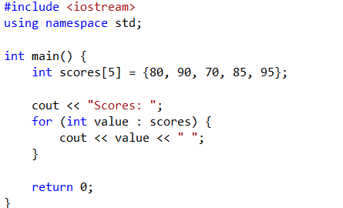

example

Slide 5
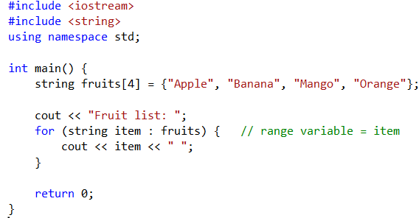

Example

Slide 6
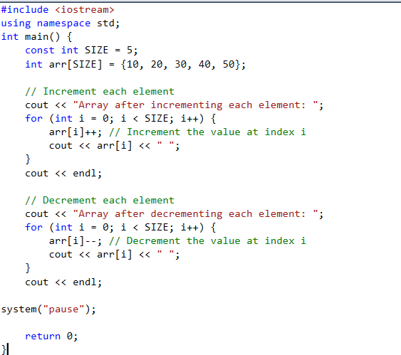

Using Increment and Decrement Operators with Array Elements
When using ++ and -- operators, don’t confuse the element with the subscript
tests[i]++; // adds 1 to tests[i]
tests[i++]; // increments i, but has
// no effect on tests
// array value.

Slide 7
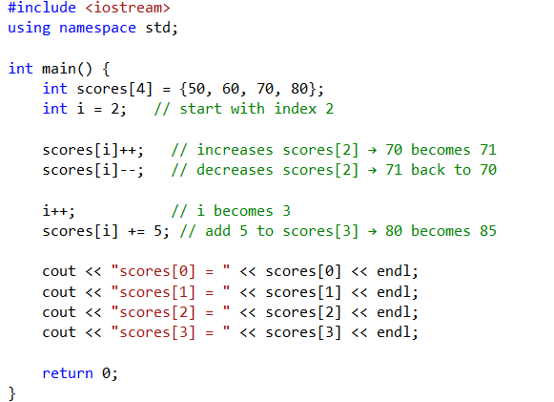
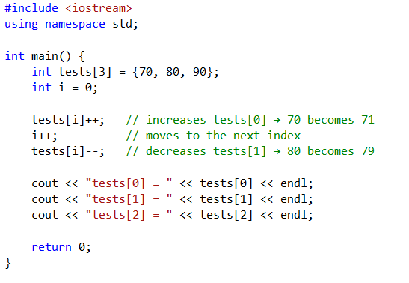
Example
Program Output:
scores[0] = 50
scores[1] = 60
scores[2] = 70
scores[3] = 85
Program Output:
tests[0] = 71
tests[1] = 79
tests[2] = 90

Slide 8
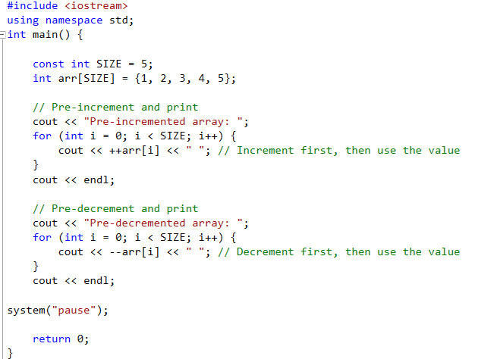

Example

Slide 9
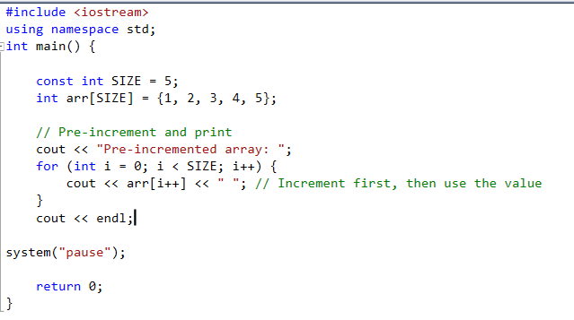

Example

Slide 10
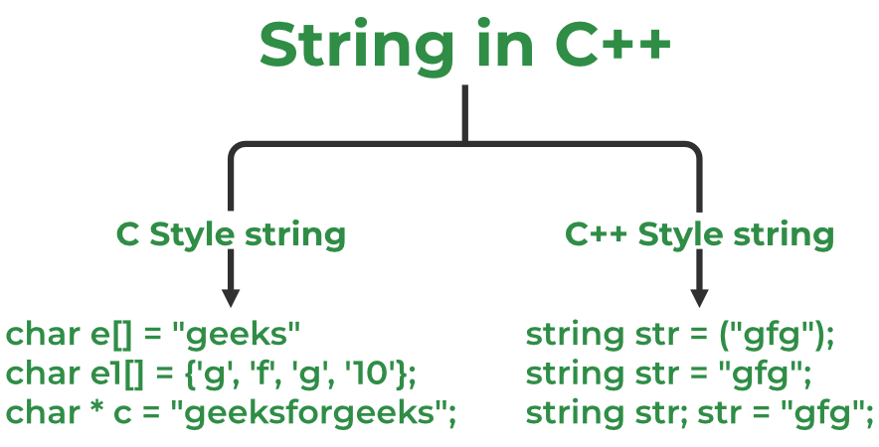
C-Strings and string Objects
Can be processed using array name
Entire string at once, or
One element at a time by using a subscript
string city;
cout << "Enter city name: ";
cin >> city;
'S' | 'a' | 'l' | 'e' | 'm'
city[0] | city[1] | city[2] | city[3] | city[4]
Notes:
See pr8-12.cpp

Slide 11

C-Strings and string Objects
char str[] = "C++";
char str[4] = "C++";
char str[] = {'C','+','+','\0'};
char str[4] ={'C','+','+','\0'};
Notes:
See pr8-12.cpp

Slide 12


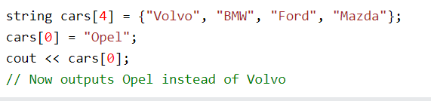
String array
Declare an array
To insert values into it
Access the Elements of an Array
Change an Array Element

Slide 13
Using C-Strings
C-string is stored as an array of characters
Programmer must indicate maximum number of characters at definition
const int SIZE = 5;
char temp[SIZE] = "Hot";
NULL character (\0) is placed after final character to mark the end of the string
Programmer must make sure array is big enough for desired use; temp can hold up to 4 characters plus the \0.
Reading in a C-string:
const int SIZE = 10;
char Cstr[SIZE];
cin >> Cstr;
H o t \0
Notes:
See pr3-26.cpp

Slide 14
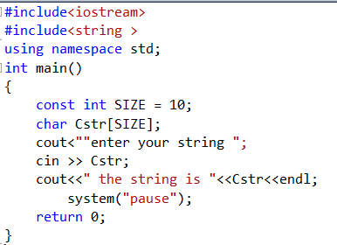

C-String Input
Reading in a C-string
const int SIZE = 10;
char Cstr[SIZE];
cin >> Cstr; // Reads in a C-string with no blanks. Will write past the
// end of the array if input string is too long.

Slide 15
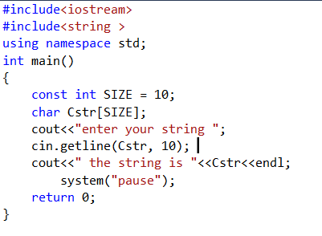

C-String Input
cin.getline(Cstr, 10); // Reads in a C-string that may contain blanks.
// Ensures that <= 9 // chars are read in.

Slide 16
C-String Initialization vs. Assignment
A C-string can be initialized at the time of its creation, just like a string object
const int SIZE = 10;
char month[SIZE] = "April";
However, a C-string cannot later be assigned a value using the = operator; you must use the strcpy() function
char month[SIZE];
month = "August" // wrong!
strcpy(month, "August"); //correct
Notes:
See pr3-27.cpp, pr3-28.cpp, and pr3-29.cpp

Slide 17
C-String and Keyboard Input
Must use cin.getline()to put keyboard input into a C-string
Note that cin.getline() ≠ getline()
Must indicate the target C-string and maximum number of characters to read:
const int SIZE = 25;
char name[SIZE];
cout << "What's your name? ";
cin.getline(name, SIZE);
Notes:
See pr3-30.cpp

Slide 18
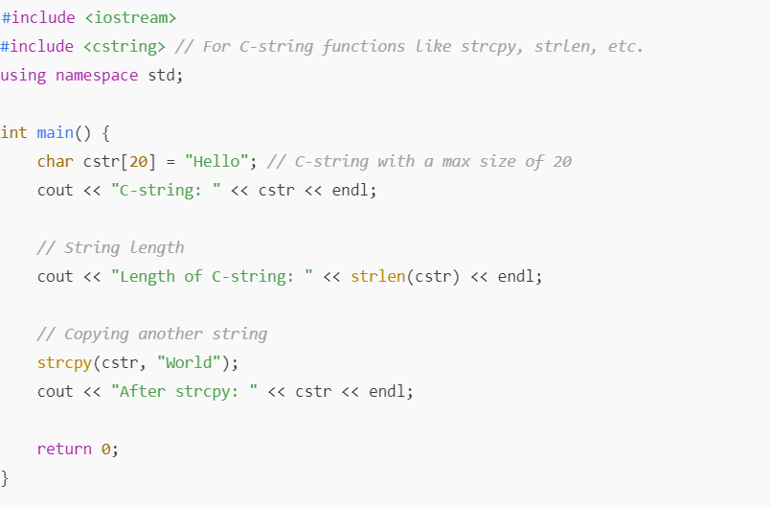
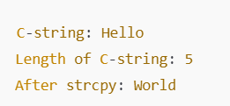
Example

Slide 19
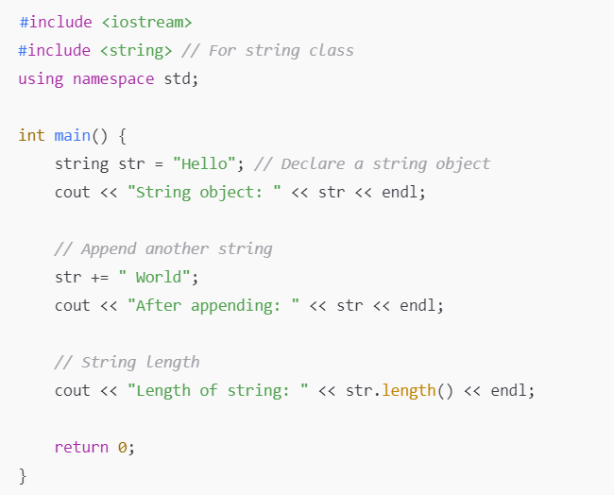
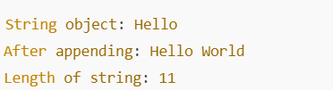
Example

Slide 20
Two-Dimensional Arrays

Slide 21
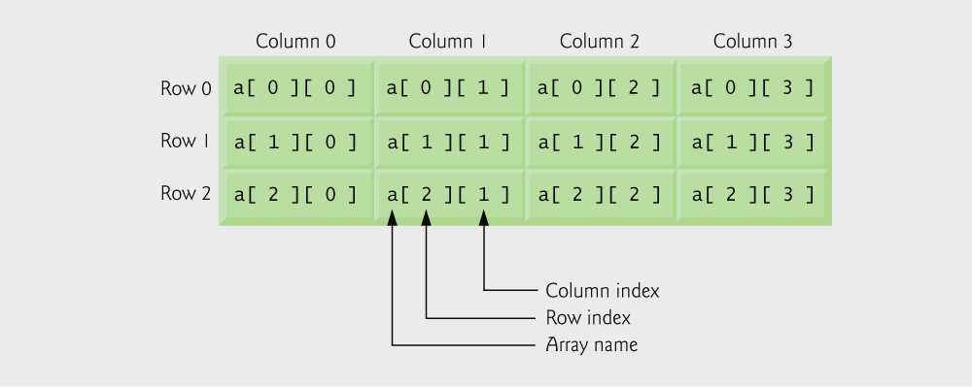

Two-Dimensional Arrays
Can define one array for multiple sets of data
Like a table in a spreadsheet
Use two size declarators in definition
Syntax of 2D array
Where,
n: Number of rows.
m: Number of columns.
int exams[3[3];
Number of rows
Number of cols

Slide 22
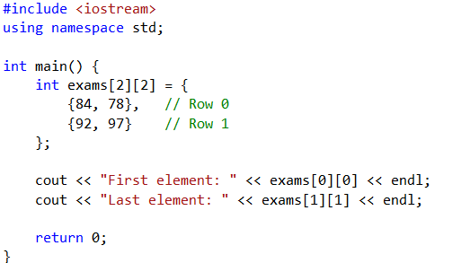
Initialization at Definition
Two-dimensional arrays are initialized row-by-row
int exams[2][2] = { {84, 78},
{92, 97} };
Can omit inner { }
84 | 78
92 | 97
0 | 0
0 | 0

Slide 23
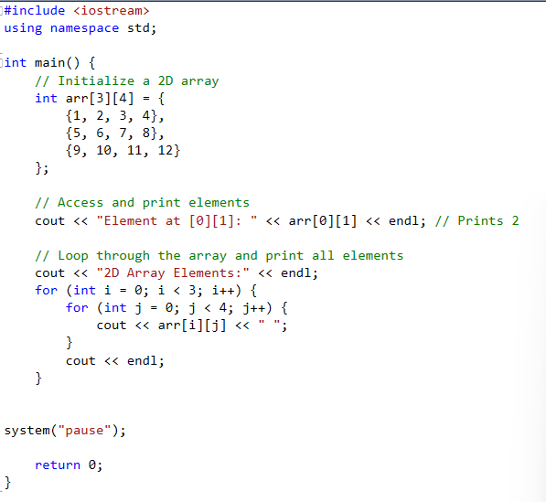
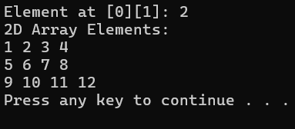
Initialization and Access of two-dimension array

Slide 24
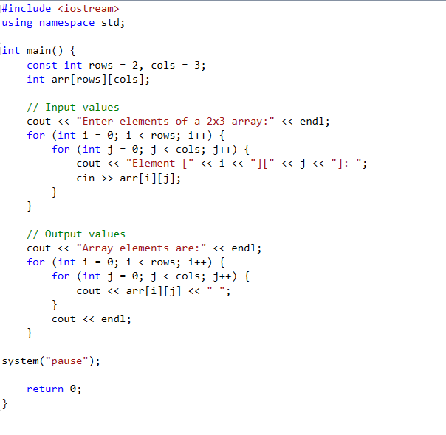
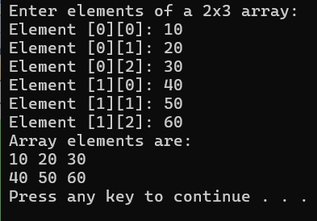
Inputting and Outputting Multi-Dimensional Arrays

Slide 25
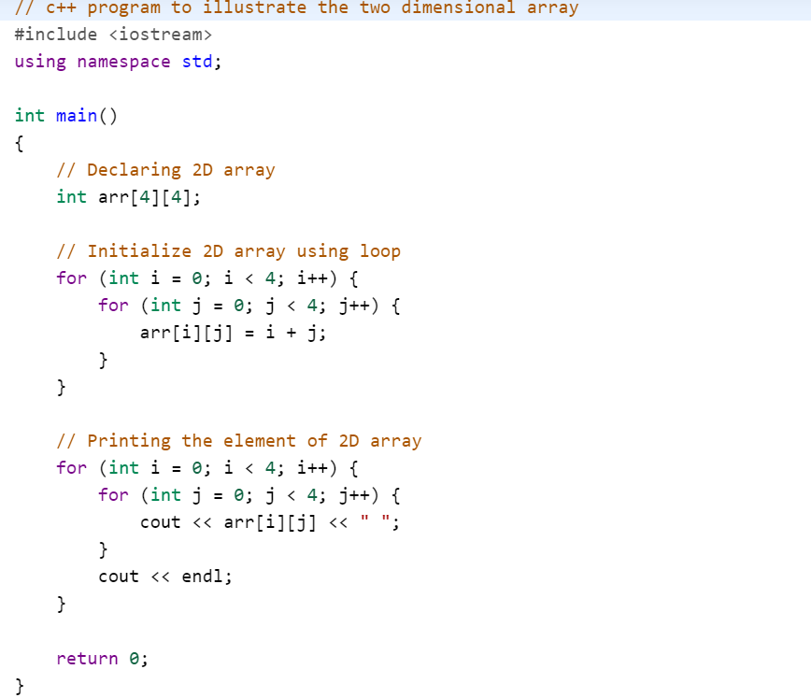
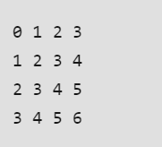
Example

Slide 26
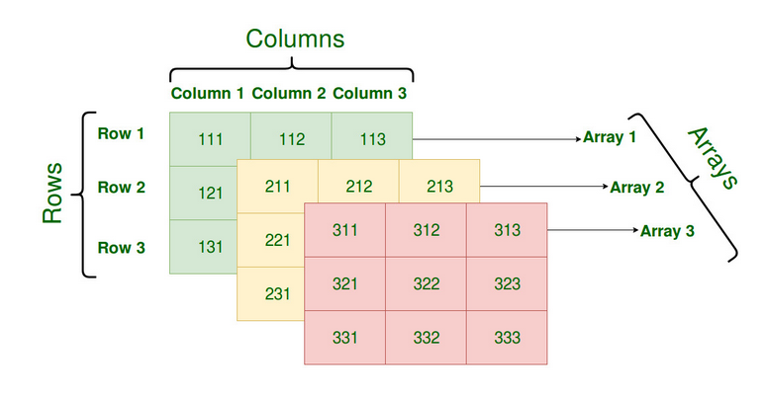
Arrays with Three or More Dimensions
Arrays[3][3][3];
Example:
int three_d[10][20][30];
int x[5][10][20]; // store total (5*10*20) = 1000 elements.
int arr[2][3][3];
int myfirst3DArray[3][4][2];
double timeGrid[3][4][3][4];

Slide 27
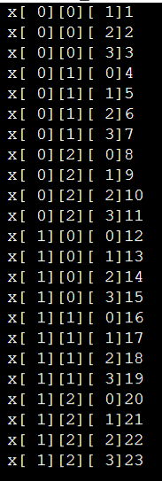
Arrays with Three or More Dimensions
Example:
int x[2][4][3] = { { {0,1,2}, {3,4,5} ,{6,7,8}, {9,10,11} }, { {12,13,14}, {15,16,17}, {18,19, 20}, {,21,22,23} } };

Slide 28
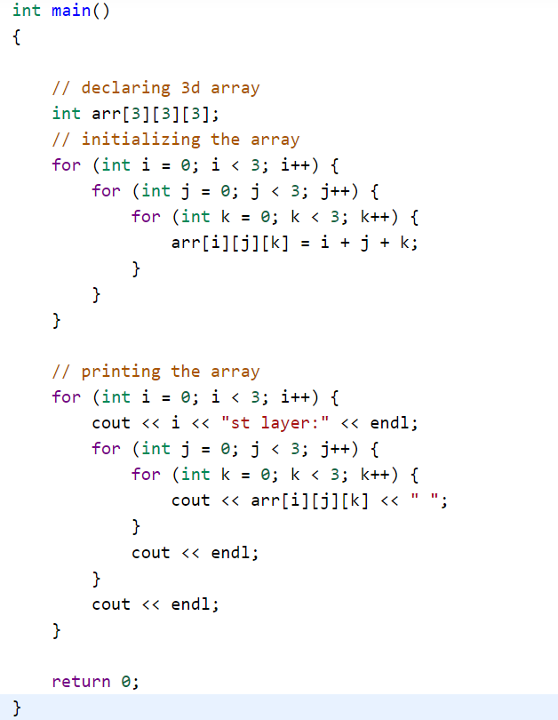
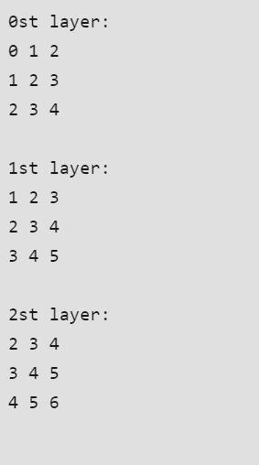
Example

Slide 29
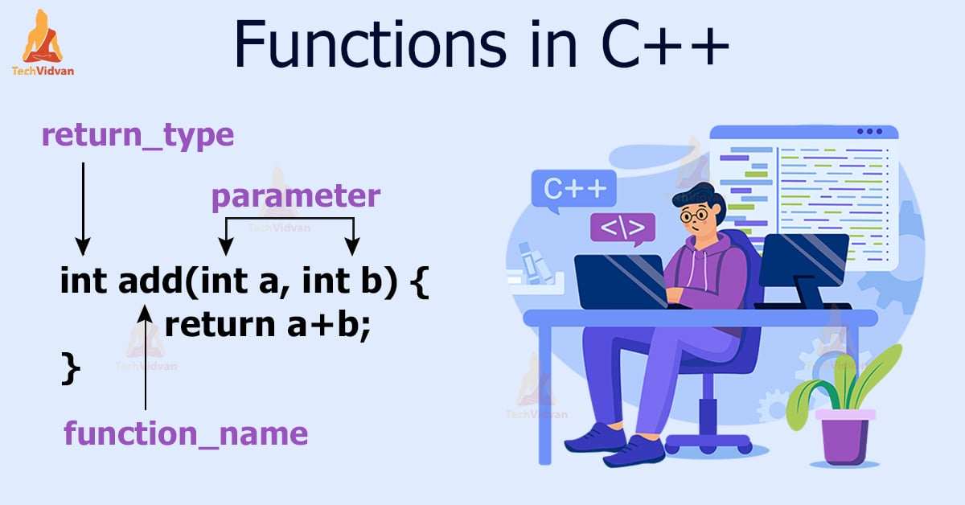

Slide 30
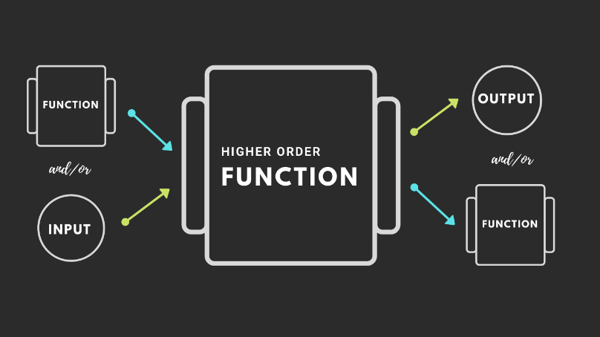
Modular Programming
Modular programming: breaking a program up into smaller, manageable functions or modules.
Functions are used to provide modularity to a program.
Creating an application using function makes it easier to understand, edit, check errors etc.
Functions allow to structure programs in segments of code to perform individual tasks.
In C++, a function is a group of statements that is given a name, and which can be called from some point of the program.
Function: a collection of statements to perform a task.

Slide 31
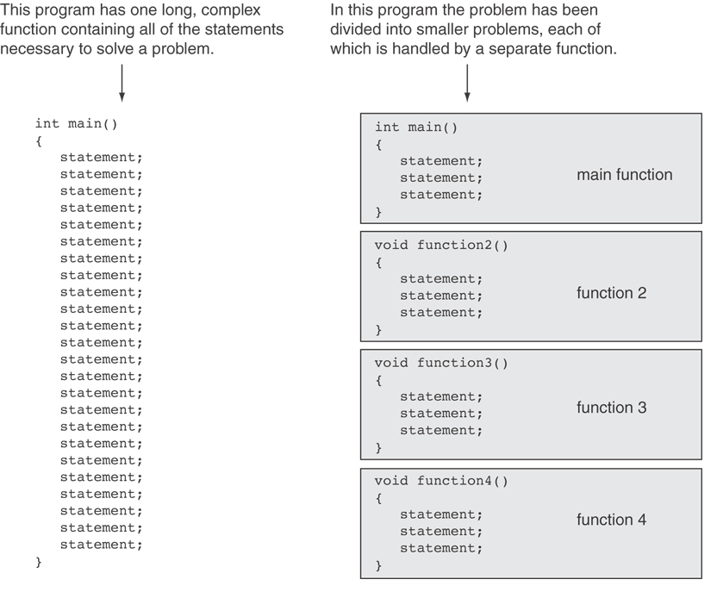

Slide 32
Functions and subprograms
The Top-down design approach is based on dividing the main problem into smaller tasks which may be divided into simpler tasks, then implementing each simple task by a subprogram or a function
A C++ function or a subprogram is simply a chunk of C++ code that has
A descriptive function name, e.g.
computeTaxes to compute the taxes for an employee
isPrime to check whether or not a number is a prime number
A returning value
The computeTaxes function may return with a double number representing the amount of taxes
The isPrime function may return with a Boolean value (true or false)

Slide 33
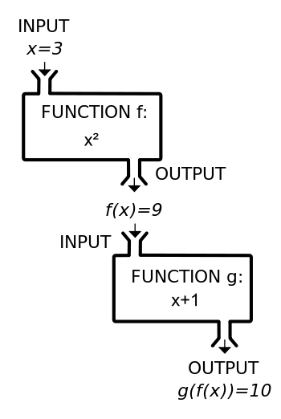
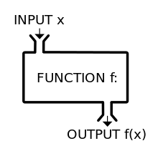
What is a Function?
A function is a block of code that performs a specific task.
A function is a set of statements that takes input, does some specific computation, and produces output.
f(x) = x
f(x) = x²
g(y) = y+1

Slide 34
Functions
Function makes the programs more modular and easy to read and manage.
Function makes solving a complex problem easier by dividing it into several smaller parts.
The main() then uses these functions to solve the original problem.
It is used for repetitive tasks.

Slide 35
Advantages
Support for modular programming
Reduction in program size.
Code duplication is avoided.
Code reusability is provided.
Functions can be called repetitively.
A set of functions can be used to form libraries

Slide 36
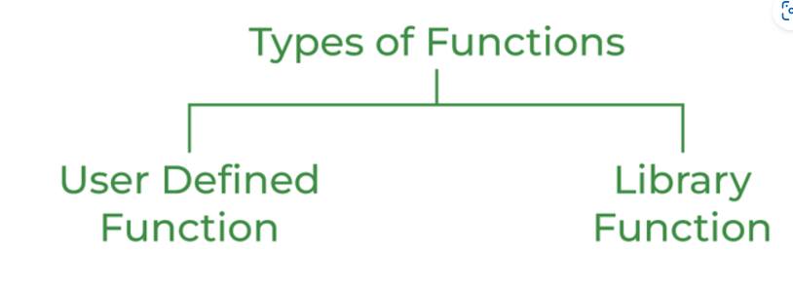
Function in C++
C++ allows the use of both internal (user-defined) and external (built-in) functions.
Depending on whether a function is predefined or created by the programmer; there are two types of function:
1. Built in(library) Function
2. User-defined Function

Slide 37
Built in Function( library)
A library function refers to a pre-written function provided by a programming library or language standard library
are part of compiler package.
Part of standard library made available by compiler.
Can be used in any program by including respective header file
To use a library function, you often need to include the corresponding library in your code

Slide 38

Example of built in function
Example
Mathematics Functions:
sqrt(x) - Returns the square root of x.
pow(x, y) - Computes $x^{y}$.
abs(x) - Returns the absolute value of x.
String Functions:
strlen(s) - Returns the length of string s.
strcpy(dest, src) - Copies the string from src to dest.
strcmp(s1, s2) - Compares two strings.

Slide 39
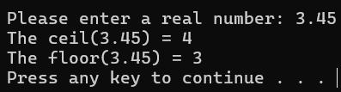
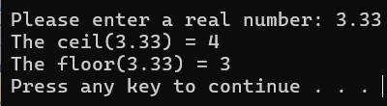
Example of Using Standard C++ Math Functions
#include <iostream>
#include <math>
Using namespace std;
void main()
{
// Getting a double value
double x;
cout << "Please enter a real number: ";
cin >> x;
// Compute the ceiling and the floor of the real number
cout << "The ceil(" << x << ") = " << ceil(x) << endl;
cout << "The floor(" << x << ") = " << floor(x) << endl;
}

Slide 40
User-defined Function
A user-defined function in C++ is a function that is written by the programmer to perform a specific task.
Created by programmer.
Created as per requirement of the program.
Unlike built-in library functions, user-defined functions allow you to create custom functionality tailored to the needs of your program.
Example
ADDfunction
Compute Area

Slide 41
Functions
What if this operation is not that too simple.
For example,
z = (x + y) / (x * x) + (y * y)
Program
main()
{
int a, b, x, y;
int c = a + b;
int z = x + y;
}
main()
Add()
Will we repeat the whole computation every time we need it?!

Slide 42
Function Definition/Calling
A Function Definition contains the statements that make up the function.
All Function Definitions have the following parts:
return type: data type of the value that function returns to the part of the program that called it
name: name of the function. Function names follow same rules as variables
parameter list: variables containing values passed to the function
body: statements that perform the function’s task, enclosed in {}
Function Header
A Function Call is a statement that causes a function to execute.
The “main()” Function is the only function in c++ that called automatically when a program starts, others need call statement.

Slide 43
Function Definition/Calling
Functions can be defined before the main function
#include <iostream>
using namespace std;
void PrintMessage()
{
cout << "I am a function" << endl;
}
void main()
{
PrintMessage();
}
Function Header
Function Body
Function Call

Slide 44
Function Prototype
A function prototype eliminates the need to place a function definition before all calls of the function.
This prototype (Function Declarations) looks similar to the Function Header, except there is a semicolon at the end.
A function prototype usually placed directly after the “using namespace std” statement.
The function prototype has the following syntax:
return_type function_name ( parameter list);
Example: Write a function prototype that returns the absolute value of an integer is:
int absolute(int x);
Or
int absolute(int);

Slide 45
Function Declaration
Functions can be defined after the main function, as long as a function prototype has first been declared
#include <iostream>
using namespace std;
void PrintMessage();
void main()
{
PrintMessage();
}
void PrintMessage()
{
cout << "I am a function" << endl;
}
Function Declaration (Prototype)
Function Call
Function Definition

Slide 46
Function Declaration
#include <iostream>
using namespace std;
void PrintMessage();
void main()
{
PrintMessage();
}
void PrintMessage()
{
cout << "I am a function" << endl;
}
Don’t forget the semicolon in the function declaration (prototype) and function call
No semicolon in the function definition
(After the function header)

Slide 47
Function Example
#include <iostream>
using namespace std;
int Add (int a, int b);
void main()
{
int z = Add(5, 3);
cout << "The result is " << z << endl;
}
int Add (int a, int b)
{
int result = a + b;
return result;
}
#include <iostream>
using namespace std;
int Add (int a, int b)
{
int result = a + b;
return result;
}
void main()
{
int z = Add(5, 3);
cout << "The result is " << z << endl;
}
Function Declaration (Prototype)
Function Definition
Function Call
Function Definition
Function Call

Slide 48
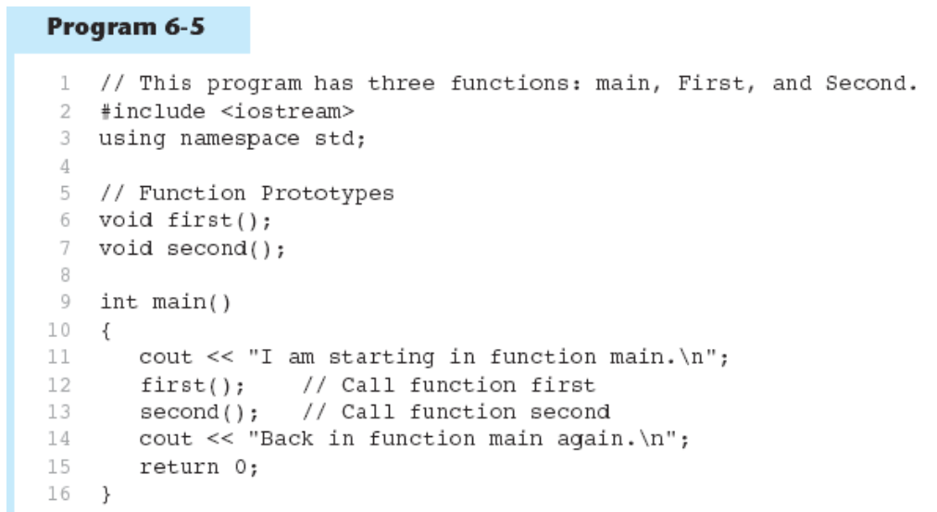
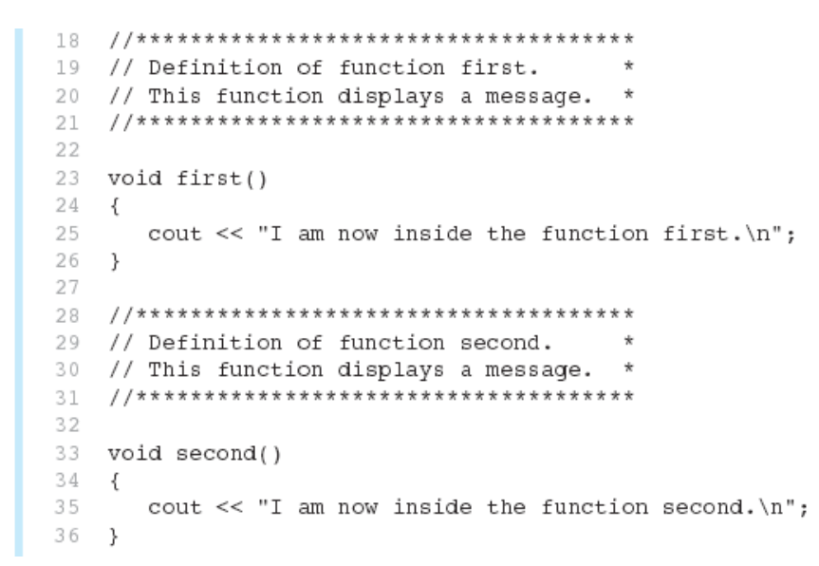
Function Example Function Prototypes in Program

Slide 49
Function Return Type
Return Type
return
void
If a function returns a value, the type of the value must be indicated: int main()
If a function does not return a value, its return type is void:

Slide 50
Function Return data type
Return data type is int
#include <iostream>
using namespace std;
int Add (int x, int y);
void main()
{
int z = Add(5, 3);
cout << "The result is " << z << endl;
}
int Add (int a, int b)
{
int result = a + b;
return result ;
}
return Statement

Slide 51
Function Return data type
#include <iostream>
using namespace std;
void PrintMessage()
{
cout << "I am a function" << endl;
}
void main()
{
PrintMessage();
}
void means that the function returns nothing

Slide 52
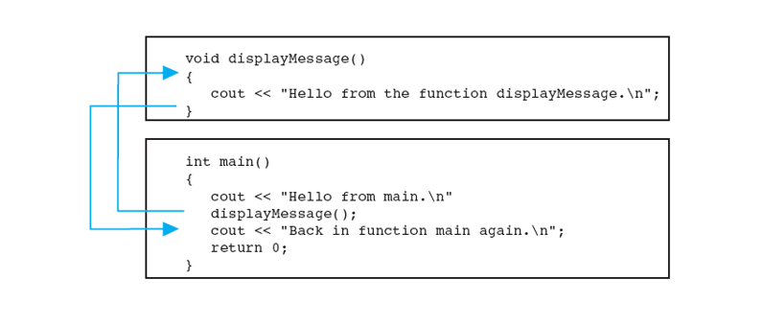
Calling a Function
To call a function, use the function name followed by () and ;
PrintMessage();
When called, program executes the body of the called function After the function terminates, execution resumes in the calling function at point of call.

Slide 53
Calling Functions
main can call any number of functions
Functions can call other functions
Compiler must know the following about a function before it is called:
name
return type
number of parameters
data type of each parameter

Slide 54
Arguments/Parameters in Function
A parameter is a special variable that holds a value being passed as an argument into a function.
The arguments called “actual parameters” and the parameters called “formal parameters”.
Any argument listed inside the parentheses of a function call is copied into the function’s parameter variable.
one-to-one correspondence between the arguments in a function call and the parameters in the function definition.

Slide 55
Arguments/Parameters in Function
int argument1;
double argument2;
// function call (in another function, such as main)
result = fun_name( argument1, argument2);
// function definition
int fun_name(int parameter1, double parameter2)
{
// Now the function can use the two parameters
// parameter1 = argument1, parameter2 = argument2
}

Slide 56
Arguments/Parameters in Function
#include <iostream>
using namespace std;
int Add (int x, int y);
void main()
{
int z = Add(5, 3);
cout << "The result is " << z << endl; }
int Add (int a, int b)
{
int result = a + b;
return (result);
}
Argument list
Parameters list consists of 2 integer parameters

Slide 57
Example
Create a function named max which accepts two numbers as arguments. The function should return the larger of the two numbers?
int max(int a,int b){
if( a >= b )
return a;
else
return b;
}
void main( )
{
cout<<"Max is: "<<max(60,60)<<endl;
system("pause");
}

Slide 58
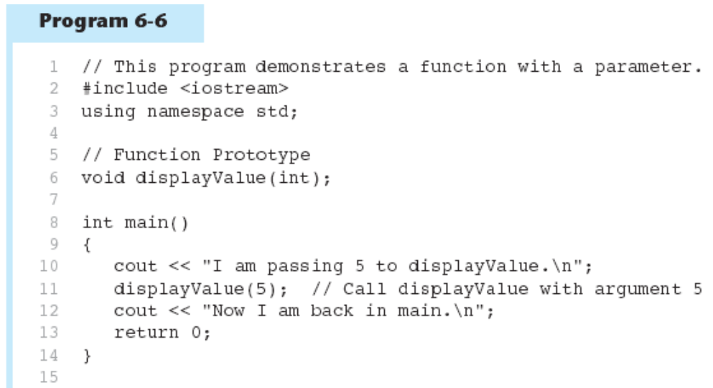
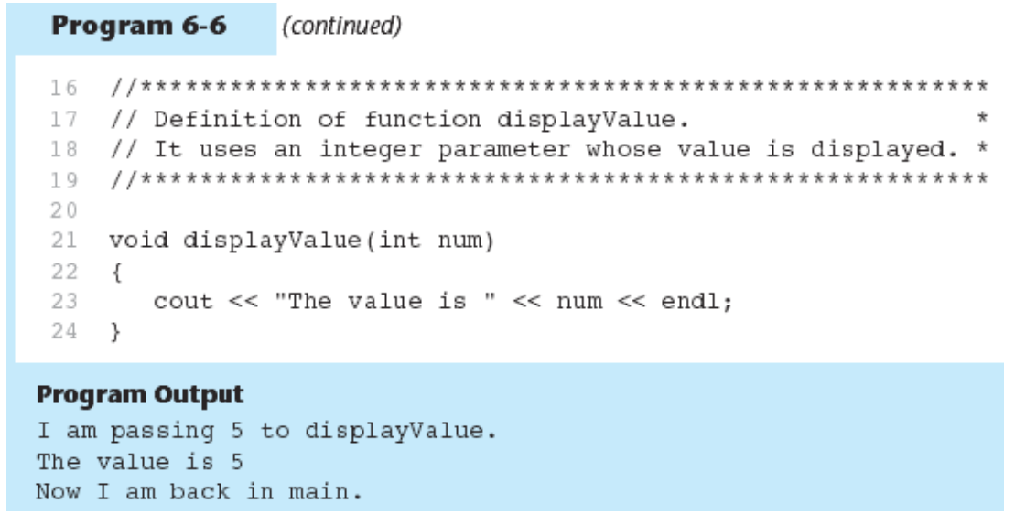
Example Function with a Parameter

Slide 59
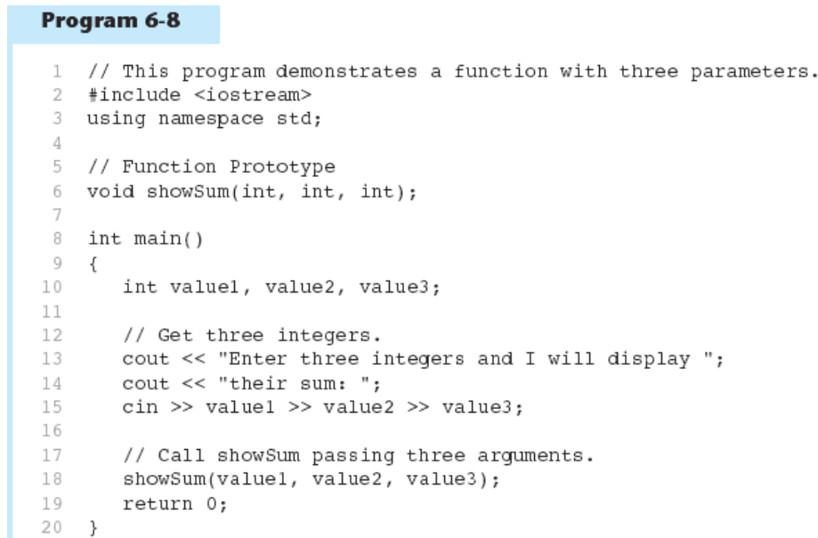
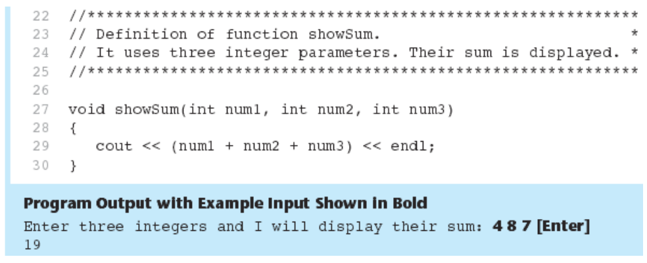
Example Passing Multiple Arguments

Slide 60
The return Statement
Used to end execution of a function
Can be placed anywhere in a function
Statements that follow the return statement will not be executed
In a void function without a return statement, the function ends at its last }

Slide 61
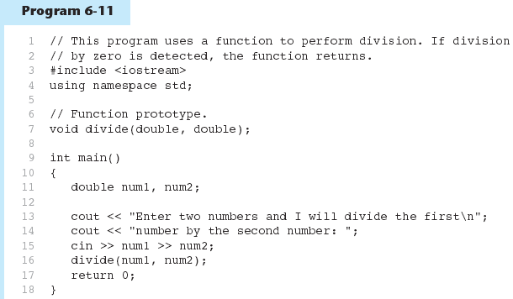
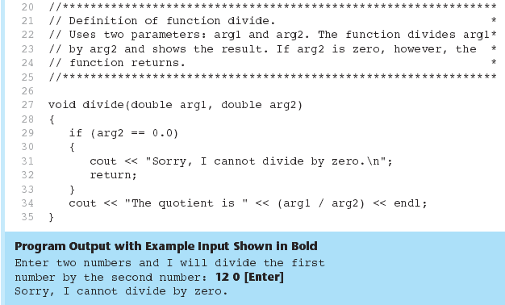
Performing Division in Program 6-11

Slide 62
Returning a Value From a Function
A function can return a value back to the statement that called the function.
You've already seen the pow function, which returns a value: double x; x = pow(2.0, 10.0);

Slide 63
Returning a Value From a Function
In a value-returning function, the return statement can be used to return a value from function to the point of call. Example:
int sum(int num1, int num2) { double result; result = num1 + num2; return result; }
Return Type
Value Being Returned

Slide 64
A Value-Returning Function
int sum(int num1, int num2) { return num1 + num2; }
Functions can return the values of expressions, such as num1 + num2

Slide 65
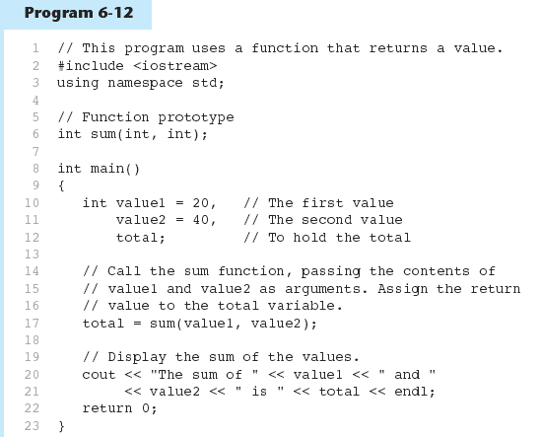
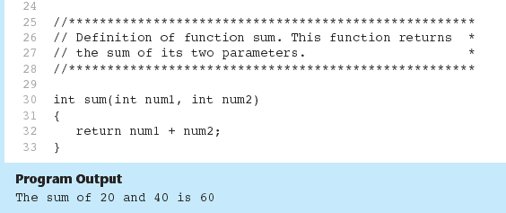
Function Returning a Value in Program 6-12

Slide 66
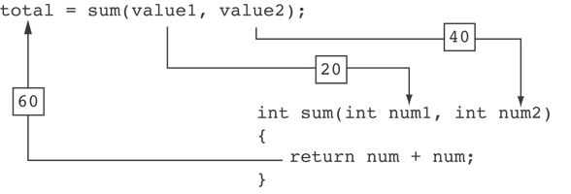
Function Returning a Value in Program 6-12
The statement in line 17 calls the sum function, passing value1 and value2 as arguments. The return value is assigned to the total variable.

Slide 67
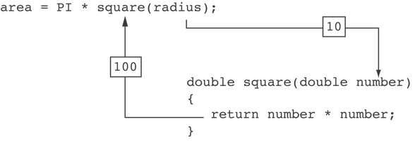
Another Example from Program 6-13

Slide 68
Returning a Value From a Function
The prototype and the definition must indicate the data type of return value (not void)
Calling function should use return value:
assign it to a variable
send it to cout
use it in an expression

Slide 69
Returning a Boolean Value
Function can return true or false
Declare return type in function prototype and heading as bool
Function body must contain return statement(s) that return true or false
Calling function can use return value in a relational expression

Slide 70

Example
Program Output:
Enter a number: 7
7 is Odd

Slide 71
Default Arguments
A Default argument is an argument that is passed automatically to a parameter if the argument is missing on the function call.
Must be a constant declared in prototype: void evenOrOdd(int = 0);
Can be declared in header if no prototype.
Multi-parameter functions may have default arguments for some or all of them: int getSum(int, int=0, int=0);

Slide 72


Default Arguments Example

Slide 73
Default Arguments
If not all parameters to a function have default values, the defaultless ones are declared first in the parameter list: int getSum(int, int=0, int=0); // OK int getSum(int, int=0, int); // NO When an argument is omitted from a function call, all arguments after it must also be omitted: sum = getSum(num1, num2); // OK sum = getSum(num1, , num3); // NO

Slide 74
Default values in parameters
When declaring a function we can specify a default value for each of the last parameters.
This value will be used if the corresponding argument is left blank when calling to the function.
// default values in functions #include <iostream> using namespace std; int divide (int a, int b=2) { int r; r=a/b; return (r); } int main () { cout << divide (12); cout << endl; cout << divide (20,4); return 0; } | 6 5

Slide 75
Default values in parameters
#include <iostream> using namespace std; int sum(int x, int y, int z = 0, int w = 0) { return (x + y + z + w); } int main() { cout << sum(10, 15) << endl; cout << sum(10, 15, 25) << endl; cout << sum(10, 15, 25, 30) << endl; return 0; } | Output 25 50 80

Slide 76


Example

Slide 77
Thank you

